Slide 1

PwC Risk Management

Slide 2


Role of Risk Management
Is Risk Management important? Why?
Reputation of the Firm
Possible litigations/claims risk
Possible adverse impact on the business (losses of clients, trouble with getting new ones etc)
PwC

Slide 3





Risk management team in PwC [Eurasia] Assurance
Partner:
Thomas Magill
Territory Assurance Risk Management Partner
Main contact:
Yuliya Kalibekova
Director
Eurasia Cluster
Main contact:
Dina Baibolova
Senior Manager
Independence
Main contact:
Yerlan Zharassov
Senior Manager,
KYC, AML SME (Subject Matter Expert)
Main contact:
Alinur Ablizova
RM Specialist
KYC, AML procedures
Notes:
Tailor slide to be applicable to your audience – i.e. if presentation for Assurance LoS, present names of the assurance risk management contacts. You may wish to add Independence team representatives names as well.

Slide 4
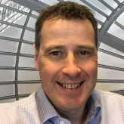

Risk management team in PwC [Eurasia] Advisory
Partner:
Paul Gleeson
Partner, Chief Risk Officer, Central and Eastern Europe
Main contact:
Nargiz Saidullayeva
Senior Manager, Eurasia Advisory R&Q
Notes:
Tailor slide to be applicable to your audience – i.e. if presentation for Assurance LoS, present names of the assurance risk management contacts. You may wish to add Independence team representatives names as well.

Slide 5



Risk management team in PwC [Eurasia] Tax&Legal
Partner:
Slawomir Krempa
Territory TLS R&Q, Eastern & Northern Cluster
Main contact:
Yernar Bakyt
Associate,
RM SME for TLP Eurasia
Main contact:
Dinara Karimova
Senior Associate,
RM SME for TLP Eurasia
Notes:
Tailor slide to be applicable to your audience – i.e. if presentation for Assurance LoS, present names of the assurance risk management contacts. You may wish to add Independence team representatives names as well.

Slide 6

Who is responsible for Risk Management in PwC?
EACH OF US!
Notes:
IMPORTANT POINTS TO TO BE DISCUSSED:
Anyone of us can expose firm
Everyone has to deal with risk management
Risk management is a teamwork
The presenter should ask the audience how they could potentially expose the firm to a risk. Various answers may be obtained, typically around losing or sharing clients’ confidential information, posting unfavorable materials about PwC on Facebook etc. The presenter should also use examples from own experience.
EXAMPLE:
Sending an offensive, private email from company mailbox to i.e goverment officals could led to a sensitive situation.

Slide 7
The types of risks we need to consider
CLIENT RISK
risk related to acceptance of new client or work
CONTRACT RISK
risk of signing improper contract
PRODUCT RISK
risks associated with the inadequacy of services to meet customer needs
PERFORMANCE RISK
risk related to service performance
LITIGATION RISK
risk of claims
1
2
3
4
5
CLIENT RISK
risk related to acceptance of new client or work
CONTRACT RISK
risk of signing improper contract
PRODUCT RISK
risks associated with the inadequacy of services to meet customer needs
PERFORMANCE RISK
risk related to service performance
LITIGATION RISK
risk of claims
Notes:
TO BE DISCUSSED IN FORM OF Q&A WITH PARTICIPANTS, NOT A LECTURE. Explain that the list provided is common, irrespective of the type of engagement
During Q&A part put emphasis on a client risk and a performance risk.
Client risk – explain how important is to serve the right clients, describe what types of checks and procedures are being done before accepting a new client. Ask participants what limitations may be in accepting additional piece of work for a client already accepted (answer: independence rules, resourcing limitations etc)
Contract risk – describe the process of accepting engagement contract clauses in your LoS/territory (OGC, RM approvals).
Product risk – state that this may happen when there was inadequate project management at the beginning. Fortunately that kind of risk materialise quite rare but in practice it would mean that a client expected a different service than we agreed/provide.
Performance risk – includes human error. Ask participants what are the ways to minimise this risk (possible answers: training, coaching, proper recruitment process, 4 eyes review of work done, risk based approach in tasks allocation)
Litigation risk – possible claims/troublesome practice matters that could result in fines, bad publicity, reputation damage. Ask the audience wheter they would prefer to settle outside the court or go to court. Discuss the pros and cons of both options.

Slide 8
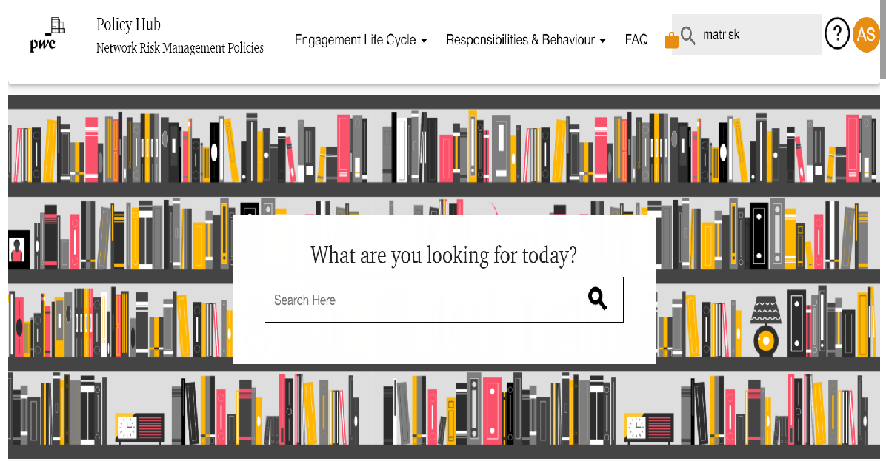
Policies and procedures
Notes:
Explain, that the main repository of RM policies and guidance is database called MATRISK. This is a global tool, because principal RM policies are the same within PwC network. Those global policies are supplemented by CEE policies as well as local ones, resulting from specific laws and rules of a given territory.
It is important to show participants Matrisk database, not only printscreen included in the presentation.

Slide 9

Network Standards
ACC, Annual Compliance Confirmation
Assurance/ Advisory/ Tax
Independence
Ethics & Business Conduct
Anti-Money Laundering
Anti-Trust & Anti-Competition
Anti-Bribery
Information Protection, etc.
Note: Refer to section 00 in Matrisk for more information
All staff confirm adherence to the network standards
Notes:
Apart from Matrisk db, RM related rules are included in network standards. Requirements from those standards are embedded into PwC processes and procedures.
Refer participants to ACC - Annual Compliance Confirmation, which requires PwC partners and staff to confirm their adherence to network standards.
Every employee is required to confirm the compliance with each network standards as part of Annual Compliance Confirmation (ACC).
Point the participants to Matrisk section 00. where, they can find summary of above mentioned standards.

Slide 10
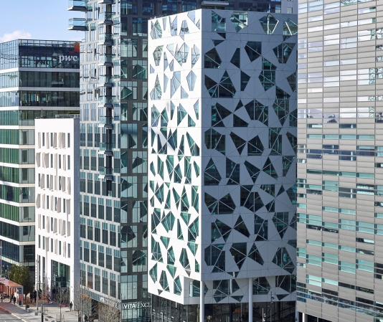
PwC Network
PwC is not a global firm. PwC is a global organisation, global network of independent firms
License/Name/Methodology/Standards
Proper, full name of Company in documentation/correspondence (i.e. PricewaterhouseCoopers Sp. z o.o., PwC Polska Sp. z o.o.)
“London office” vs “PwC UK”
Business cards/ Mail signature
Marketing
Notes:
Explain to the participants how PwC firms are organised. Emphasize that from the formal perspective it is important to use full name of PwC firm in correspondence with the 3rd parties (clients, contractors etc.) to avoid misunderstandings and committing other PwC firms.
PwC is a network of separate Member firms and should be described properly as such. Describing the Network as, or implying that it is, one firm or one global partnership increases the risks of cross-border liability or litigation for individual PwC firms and for the Network itself.
Put emphasis on fact that when describing the PwC Network or referring to work carried out by your firm and/or by other PwC firms::
Do not state or otherwise give the impression that the PwC network is 'one firm' or 'one global partnership'.
Therefore it is very important to use proper, full name of Company in which employees are working on business cards (explain how in your territory employee can receive business cards (process, person responsible in your territory) and in mail signature.
Emphasis that PwC Network operates based on same standards, methodology and procedures (which ease international transfers within the network)
Explain to the audience that in case of marketing: It is the firm's policy that PwC should be associated only with documents which have been prepared by the firm and for which the firm is responsible. The PwC brand or logo should be presented only on the face of PwC prepared documents e.g. reports to those charged with governance and reports to management. E.g. financial statements irrespective of who prints and formats them are client documents and as such are not PwC prepared documents.
Therefore, from an independence and co-branding policy perspective, financial statements (other than our attached audit opinion) or other client's documents, including any related covers should be free of the PwC brand and logo.
Practical implication of PwC structure:
Most important is to know in which PwC Firm you are employed! This fact should be reflected on your business card and in your mail signature. If you work on a project within other LoS, please discuss with the team whether it is appropriate to contact client directly as it may impose that other PwC firms are involved in project delivery than are contracted.

Slide 11

Anti-Money Laundering
What is money laundering?
Remember:
Required identification procedures
Suspicious transactions
AML Repository Database
Notes:
[Tailor this slide to reflect specific territory requirements – if there aren’t any -> please refer to Global PwC rules – Matrisk AML Policy (section 20)]
THE IMPORTANCE OF AML PROCEDURES RESULTS FROM THE BASIC ASSUMPTION THAT WE DO NOT WANT TO WORK WITH/FOR CLIENTS INVOLVED IN MONEY LAUNDERING ACTIVITIES.
Ask the audience to define money laundering:
Money laundering is the funnelling of cash or other funds generated from illegal activities through legitimate financial institutions or businesses so as to conceal the source of the funds or to make it appear that the source of the funds is, in fact, legitimate. Money laundering is a global problem, which, like the illegal activities underlying it, seldom respects local, national or international borders
Tell audience why
PwC firms provide a wide range of financial and business advisory services, and there is, therefore, a risk that PwC firms and their individuals may inadvertently become directly or indirectly involved in actual or potential money laundering activities. Therefore, all PwC member firms must have procedures for preventing and reporting money laundering.
Remember to tell the audience important points in regards due to AML policy:
Do not provide any service, or enter into any business relationship, that could constitute you or your firm being involved in direct or indirect money laundering activities
Establish your client’s identity (including the identity of any ultimate beneficial owners) in accordance with your firm’s policy
Report all knowledge or suspicion of money laundering to your firm’s nominated individual in accordance with your firm's reporting procedures
When referring or sub-contracting work to other PwC member firms, provide assistance to those firms in order to enable them to satisfy their own anti-money laundering procedures
The Risk Management standard on anti-money laundering requires all PwC Member firms to assign responsibility for compliance with the standard to a relevant individual at a sufficient level of seniority, and implement procedures for their partners and staff to inform this individual of any knowledge or suspicion of money laundering encountered during the course of client work.
Describe how the process is set up in your territory - [Tailor this part to reflect specific territory requirements]
Required procedures/documents to be done at the client acceptance/continuance stage.
Persons responsible for AML procedures in your territory
Tools used in AML procedures in your territory (checklist, database, etc.)

Slide 12
Do you know?
Client/work acceptance – KYC, A&C/affirm
Contracts – templates, changes, storage
Authority to commit a firm and signing documents
Confidentiality – using knowledge from other projects/ communication with other teams
Documentation – quality of work
Consultations
The worst mistake you can make is the one you make on your own!
1
2
01
3
06
Data Protection
02
4
05
03
5
04
6
Notes:
THIS SLIDE IS A KIND OF SUMMARY (CHECKLIST) OF IMPORTANT TOPICS FOR RISK MANAGEMENT PRESENTATION!
IF POINTS 3-6 DID NOT APPEARED EARLIER THEN SPEND SOME TIME TO DISCUSS THEM WITH THE AUDIENCE.
Specify that A&C are used for Audit work and affirm for other type of services.
Emphasis importance of using proper, current template, applicable to the scope of the work. One more time direct participants to section 27 of Matrisk, where they can find newest contracts templates.
Briefly discuss with participants who is authorised to commit PwC and sign formal reports – only Partners and authorised Directors, who supervise projects
Put emphasis on the fact that sensitive data as i.e. – financial data, information about client’s strategy are confidential and can not be shared outside the engagement team and especially with people outside the firm. In case of doubts people should seek out the advice of more experienced team members (and always use common sense)
Document your work according to PwC requirements – please remember that our documentation may be our best proof of quality of our work in case of TPM/litigation and/or other external/internal reviews. Please note that our documentation is kept for long time (according to specific retention rules)
Consultations – specify for the participants importance of support teams/departments – repeat main rm/independence/regulatory contacts in your territory [slide 3]
WHEN IN DOUBTS WE ENCOURAGE YOU TO SEEK OUT ADVICE FROM THOSE WHO MAY HAVE EXPERIENCE IN THE SUBJECT.

Slide 13
Useful links
Visit us at CEE Risk & Quality Website
Sanctions check - Link
ServiceNow support from the SSC Eurasia Advisory team RM Ticket

Slide 14
Thank you
© 2026 PwC. All rights reserved. Not for further distribution without the permission of PwC. "PwC" refers to the network of member firms of PricewaterhouseCoopers International Limited (PwCIL), or, as the context requires, individual member firms of the PwC network. Each member firm is a separate legal entity and does not act as agent of PwCIL or any other member firm. PwCIL does not provide any services to clients. PwCIL is not responsible or liable for the acts or omissions of any of its member firms nor can it control the exercise of their professional judgment or bind them in any way. No member firm is responsible or liable for the acts or omissions of any other member firm nor can it control the exercise of another member firm's professional judgment or bind another member firm or PwCIL in any way.

